Slide 1

Big Data Overview: 311 Service Calls Incoming!
By Joey Tran, Garrett Tice, Brandon Ascencio, Kyle Alfonso, and Michael Campos

Slide 2
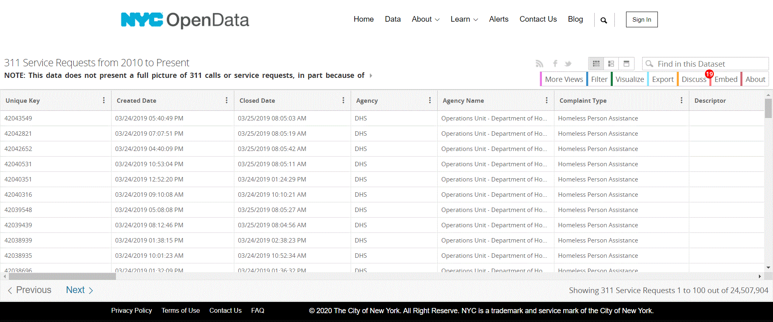
Analyzing Service Calls in NYC Non-Emergencies

Slide 3
Purpose and Benefit of 311 Service Calls
911 is for emergencies while 311 is for non-emergency service based calls. The types of complaints can vary and data.
“Can be used in order to characterize the local context of the urban neighborhood and demonstrate moderate to strong correlations with wealth, education level, unemployment, racial structure of its population”(Wang).

Slide 4
Purpose of Big Data Research and Analysis
The purpose of our analysis of 311 service calls is to survey the different types of non-emergency calls within the New York City Area between 2010 and 2020.
Analyzing the data we want to discover patterns of most and least frequent types of calls in different boroughs based on most common complaints.

Slide 5
Proposed Analysis
Determining most and least common service calls based on responding agency and the area of new york city (I.E. park borough manhattan)
What is the Park Borough with most "pounding" and greatest loud noise complaints? Could this be considered more dangerous areas to live?

Slide 6
Proposed Analysis cont.
Analyze the number of cases each agency responded to, and use the information in the reallocation of budgets.
Analyzing timeframe 2010-2020 Complaint Types (looking for most common.)

Slide 7


Analytic Software
Hadoop Hive - Querying data and creating tables
Tableau - Visualizations and analysis
Notes:
Discuss how we downloaded the file to oracle server and uploaded it to Hadoop HDFS DFS. Created tables.

Slide 8

Specifications
Cluster Version - 20.3.3-20
Cluster Number of Nodes - 3
Memory Size - 180 GB
CPU Speed - 2195.212

Slide 9
Data Source Urls
Data Size
NYC OpenData
https://data.cityofnewyork.us/Social-Services/311-Service-Requests-from-2010-to-Present/erm2-nwe9
Data size - 12.4 GB

Slide 10
Uploading the data set to the hdfs
Downloaded the data(12.3 Gb)
Compressed the data to a zip file (2.18 Gb)
Uploaded zip file to an Amazon S3 bucket
Used the S3 bucket to download to /dev/shm/ directory
Unzipped the file, and made a /Services directory in the hdfs
Moved the unzipped file to the Services Directory

Slide 11
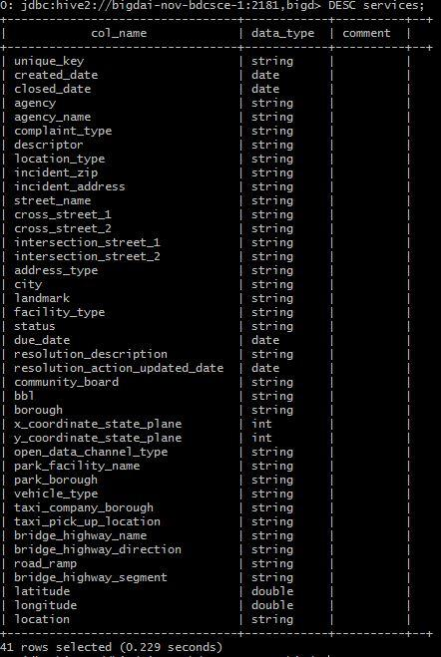
Tables - Main Database Table
Data File Format: CSV
Table Name: Services
Total columns/attributes: 41
Data types: date, int, string
Number of rows(tentative): 24,515,013

Slide 12
Queries Run to test the database
Select * from Complaints limit 50;
Select * from Complaints where agency_name LIKE 'New York City Police Department' limit 10;
Select DISTINCT * from Services Limit 100;
Select complaint_type, numberofcomplaints from Complaints where agency_name LIKE 'New York City Police Department' limit 10;

Slide 13
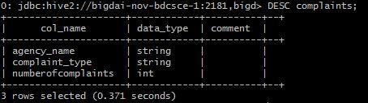
Tables - Complaints Schema
Agency_name - City govt agency responding to call
Complaint_Type - Topic of incident or condition
Numberofcomplaints - total number of complaints of each complaint type

Slide 14
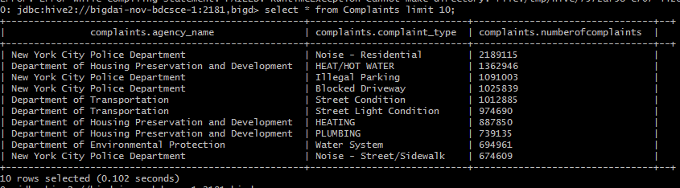
Tables - Complaints top 10 complaint types
Key takeaways
Residential noise complaints - 2,189,115
NYCPD appears 4 times

Slide 15
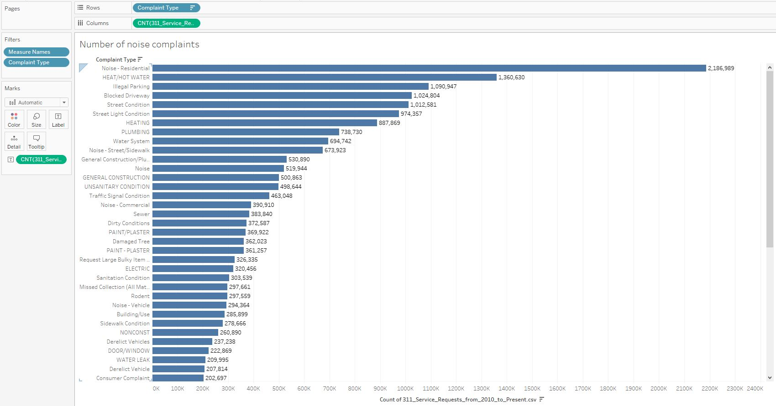
Visualization of Results of 1

Slide 16
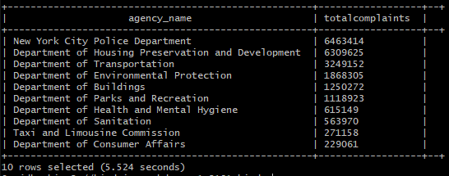
Number of Complaints handled by each Agency
NYC-PD responded to the most complaints
Housing Preservation was the second highest
Both are about double the third highest

Slide 17
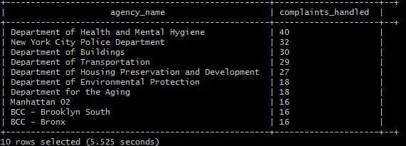
Number of complaint types per Agency
Health and mental hygiene responds to the most types of complaints
NYPD was second despite responding to the most calls

Slide 18
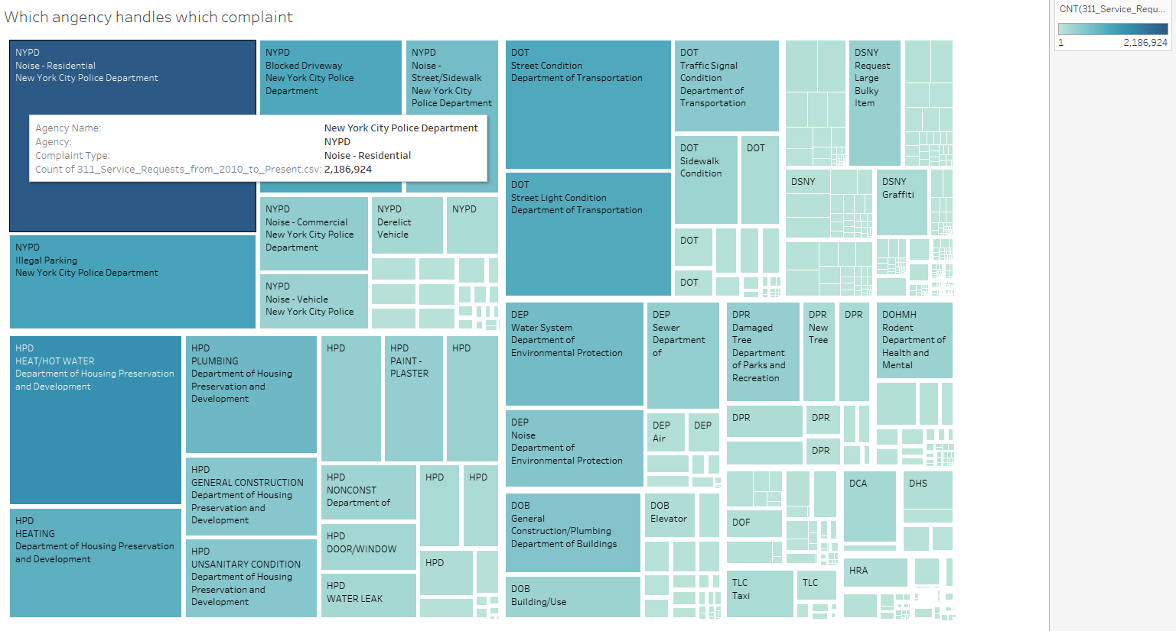
Total complaints and types by Agency

Slide 19
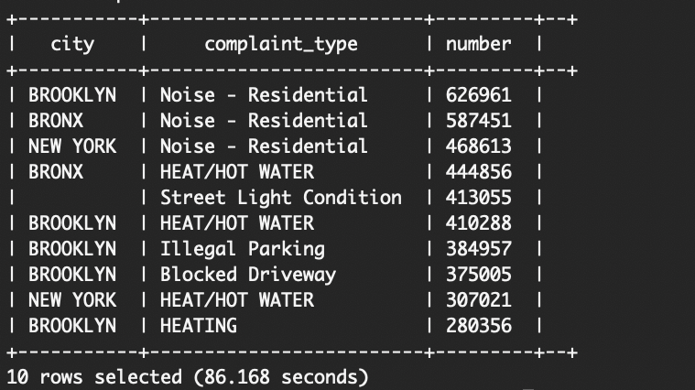
Tables - City Schema
City - city the complaint call was taken in
Complaint_Type - Topic of incident or condition
number - total # of complaints

Slide 20
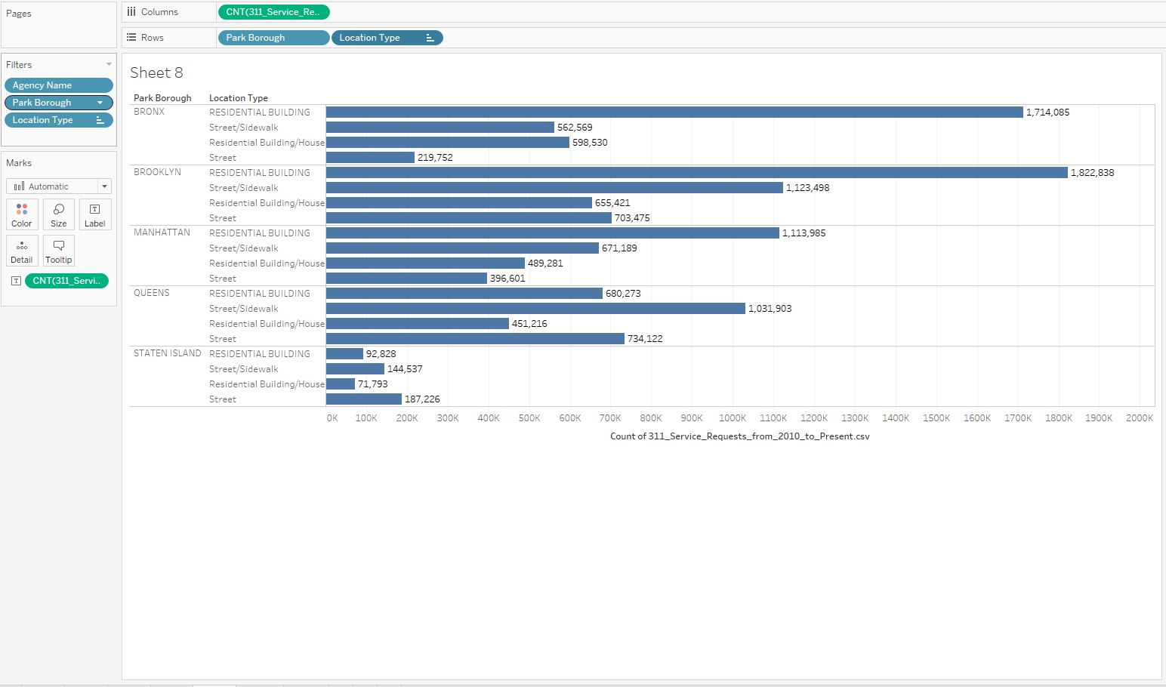
Residential Type by City

Slide 21
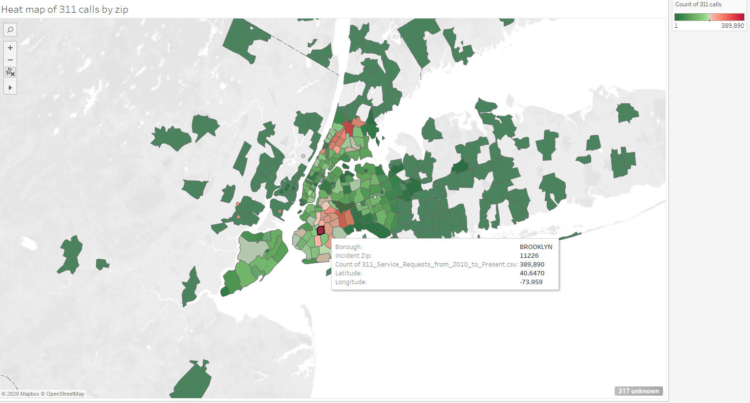
Heatmap of complaints by City

Slide 22
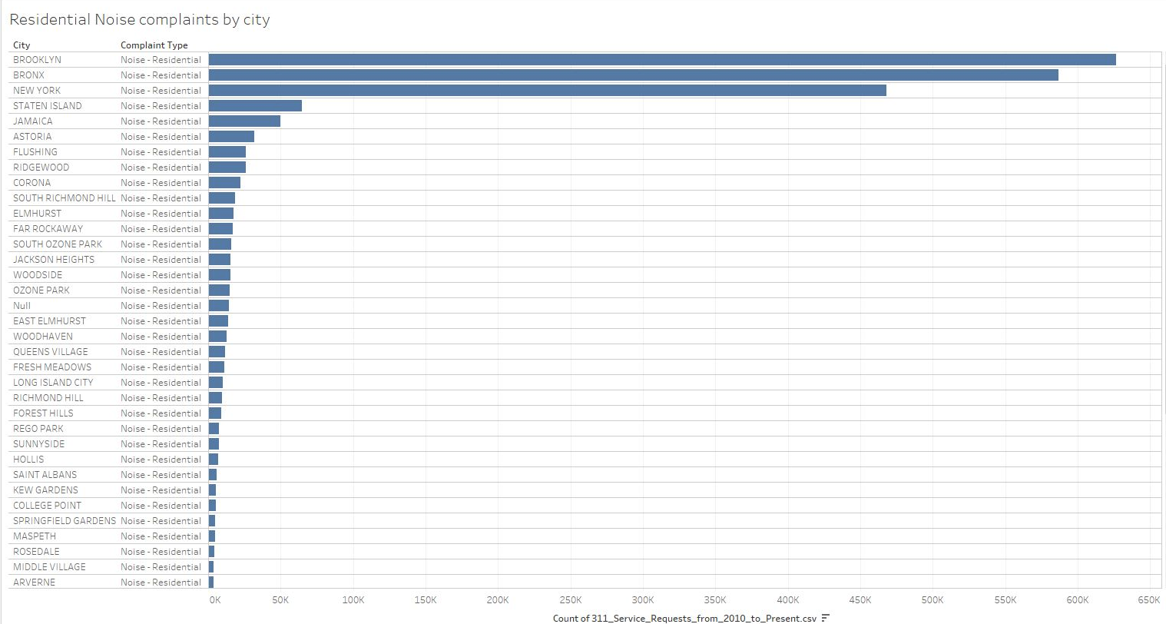
Residential Noise Complaints by City

Slide 23
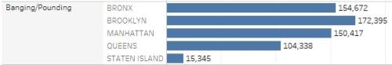
Banging/Pounding Descriptor
Most Common Area for Pounding
Figure 2. Boroughs with most common noise/related complaints (Pounding/Banging).

Slide 24
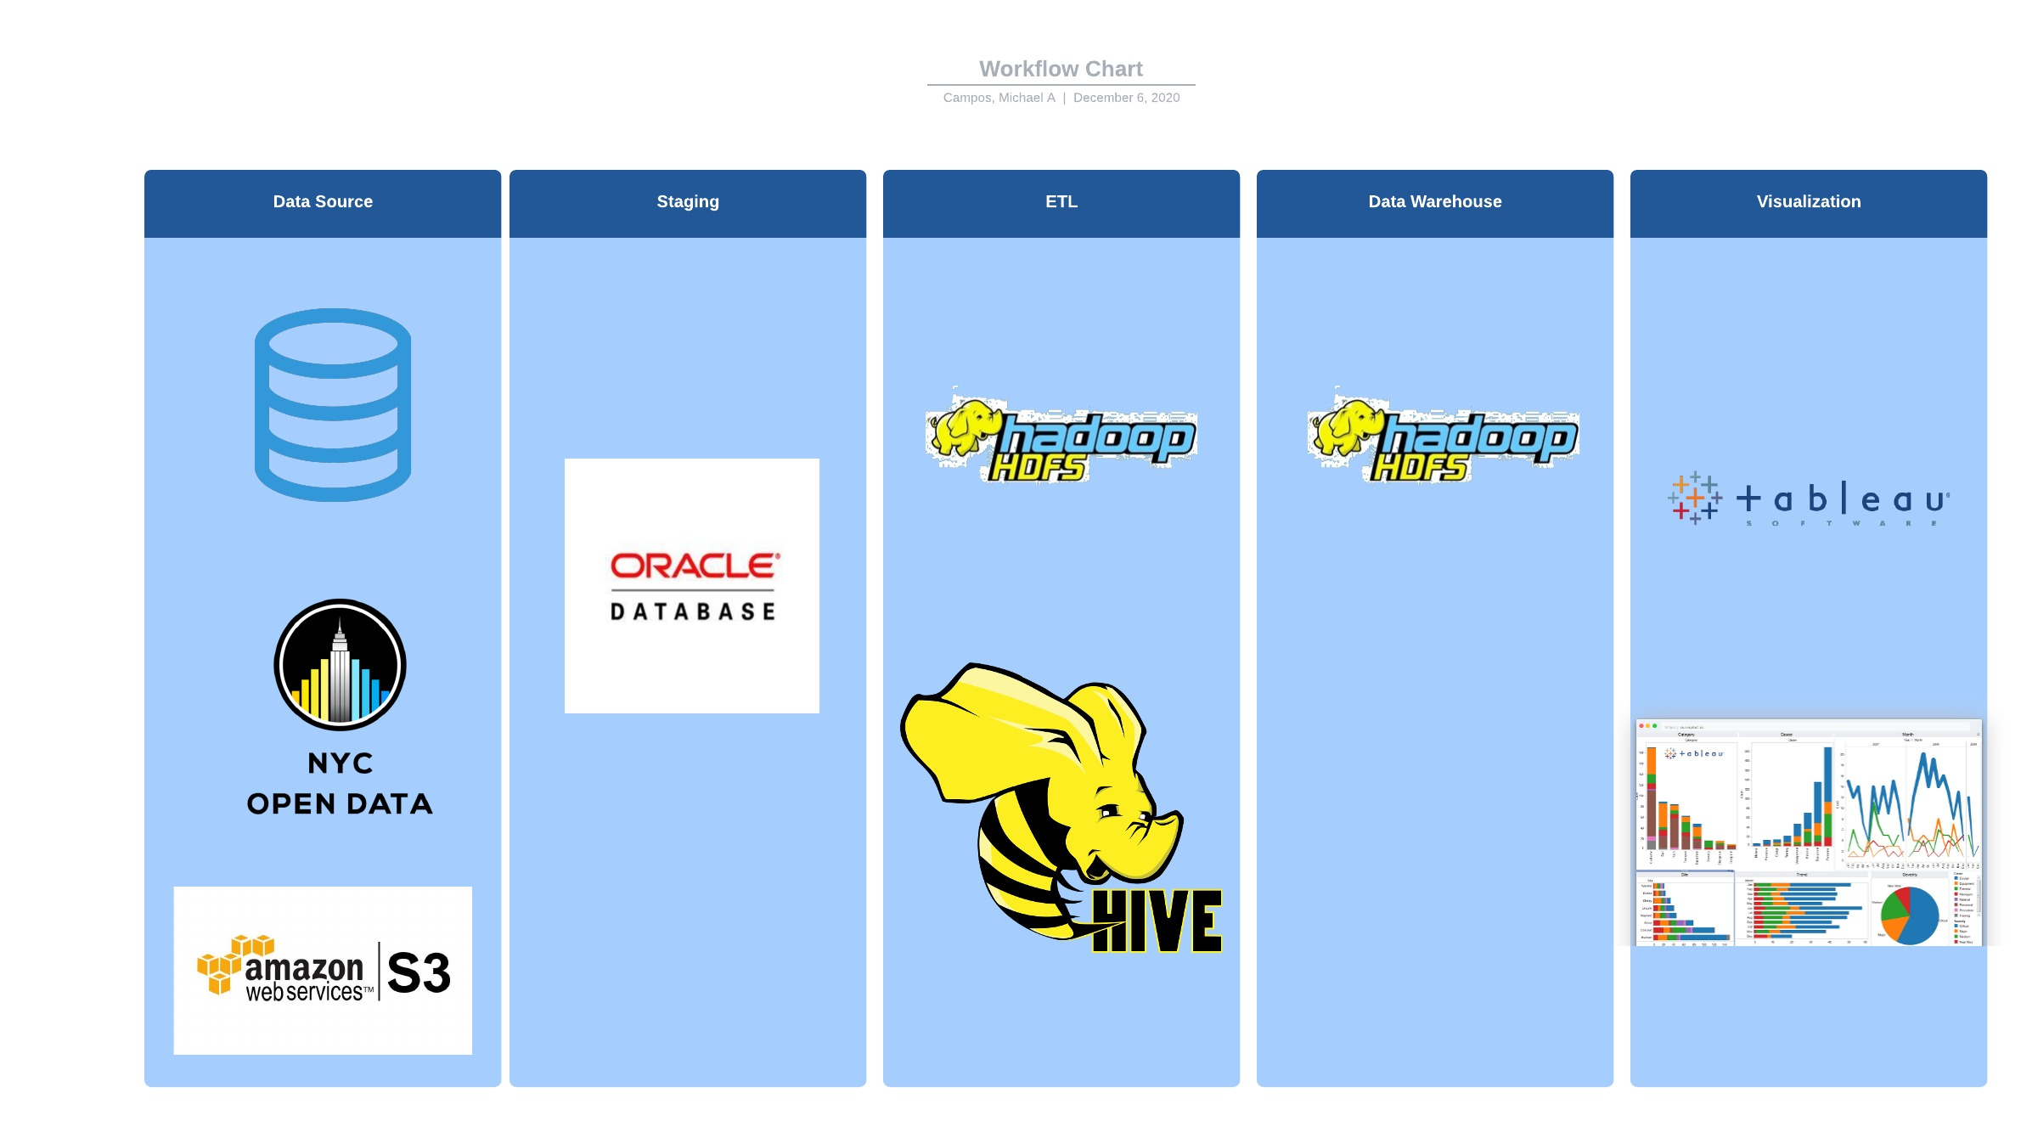
Architecture

Slide 25
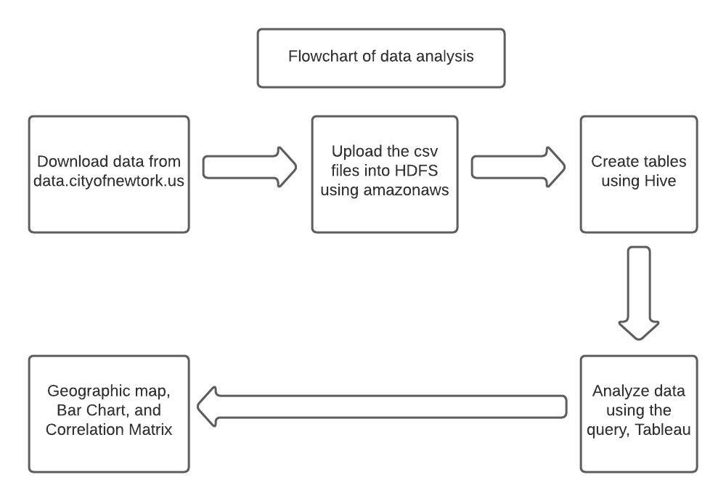
FlowChart

Slide 26
Findings
Residential noise complaints was the most common complaint type
Areas with the highest residential buildings have the highest complaints
Brooklyn and Bronx had higher numbers of residential buildings resulting in the highest noise complaints

Slide 27
Findings Cont.
NYPD and Housing Preservation were the agencies that handled the highest total of complaints received
Together they account for just over half of the complaints/records received in the data set

Slide 28

GitHub Link
https://github.com/branasce/CIS4560Project

Slide 29

Approval form the Professor

